Slide 1
VACCINATION RECORD APPLICATION
NHI TRAN
HARSHIL SHARMA
HARSH PATEL
SYEDA BUSHRA FATIMA

Slide 2
INTRODUCTION
Objective: Manage and streamline vaccination records.
Relevance: Address data storage, accessibility, and security challenges.
Core Features:
Patient record management.
Vaccination tracking and insurance storage.

Slide 3
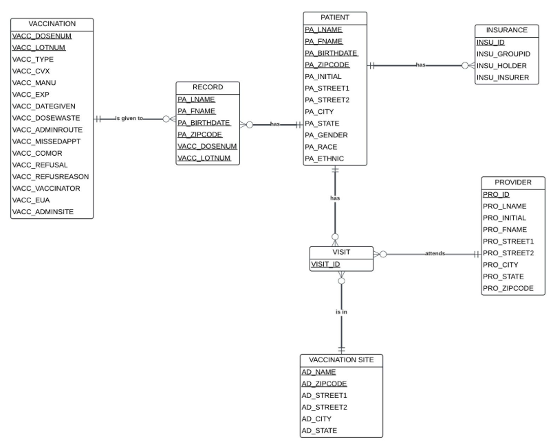
ER Diagram
Key Entities:
Patient: Stores personal and demographic information.
Vaccination: Tracks vaccine-specific details like dose, manufacturer, and lot number.
Visit: Links patients, providers, and vaccination sites.
Provider and Vaccination Site: Capture details of healthcare professionals and locations.
Insurance: Records health coverage details.
Relationships:
Patients are connected to vaccinations via visits.
Visits link providers and vaccination sites.
Design Features:
Composite keys ensure unique identification.
Normalization reduces redundancy.
Constraints maintain data integrity.

Slide 4
UI/UX Design and Implementation
Languages and Tools Used:
Frontend: HTML, CSS, JavaScript, JSP
Backend: Java (Servlets), SQL
Database: MySQL
Tools: Netbeans, MySQL Workbench

Slide 5
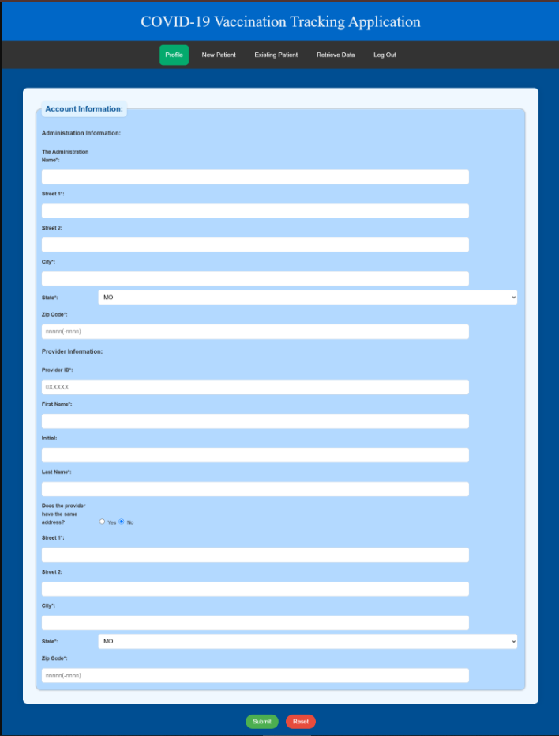
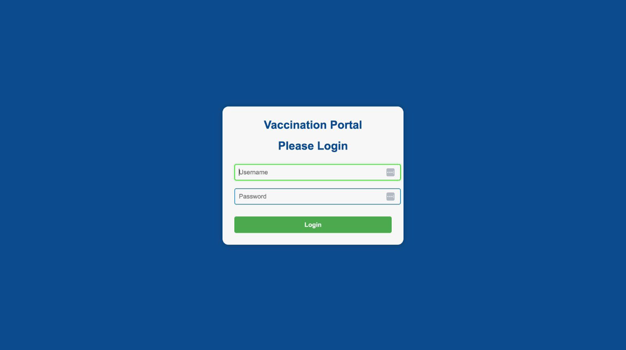
UI/UX Design and Implementation
LogIn Page:
Main Page:
Secure Provider authentication using username and password.
Intuitive navigation menu for accessing key features like:
Adding new patients.
Updating existing patient records.
Retrieving vaccination data.

Slide 6
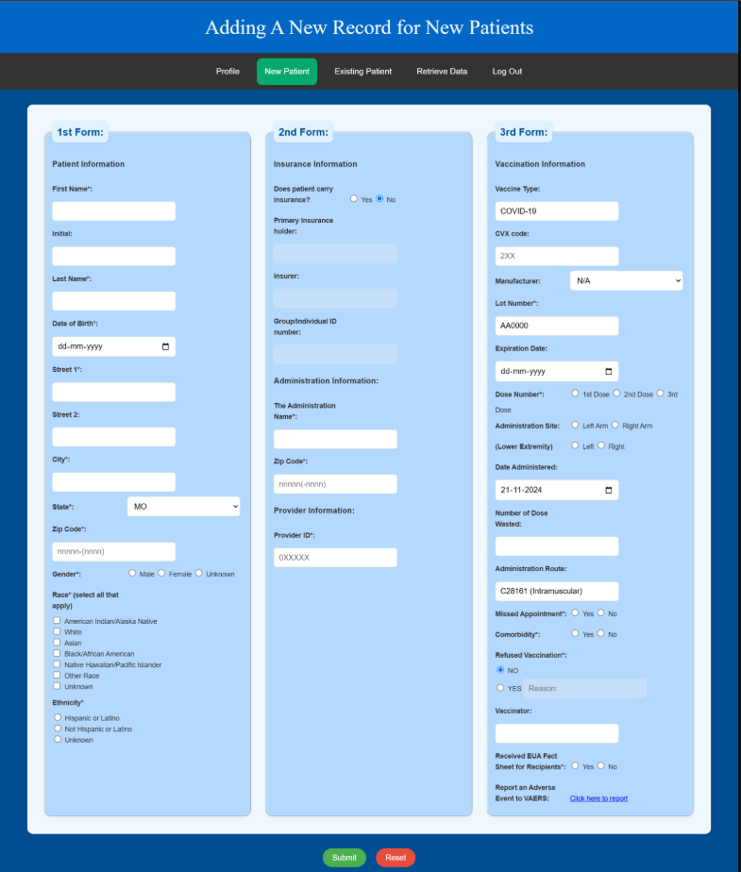
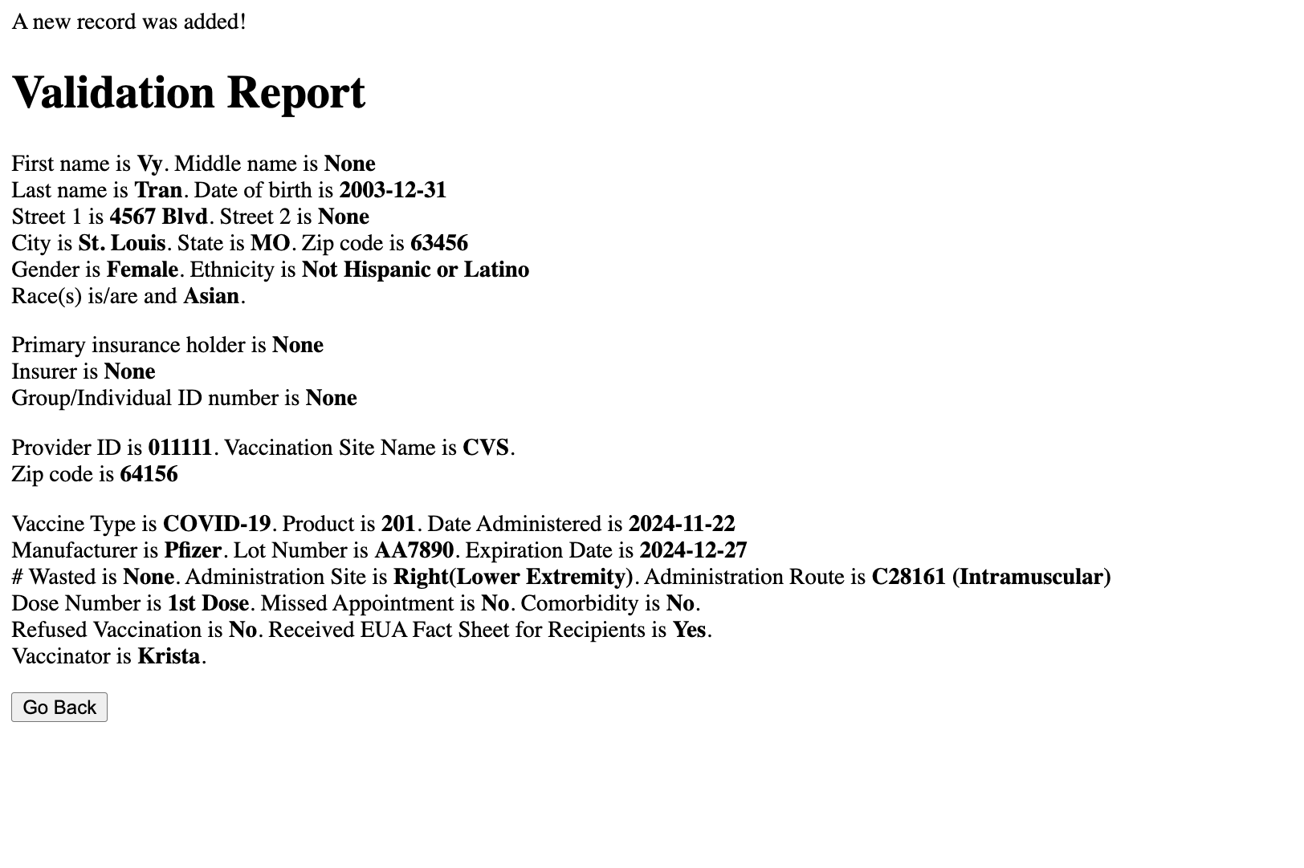
UI/UX Design and Implementation
Segmented forms for:
Patient information.
Insurance information.
Vaccination information.

Slide 7
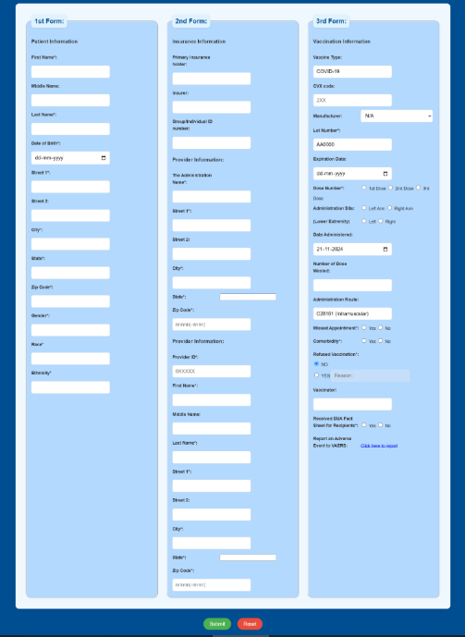
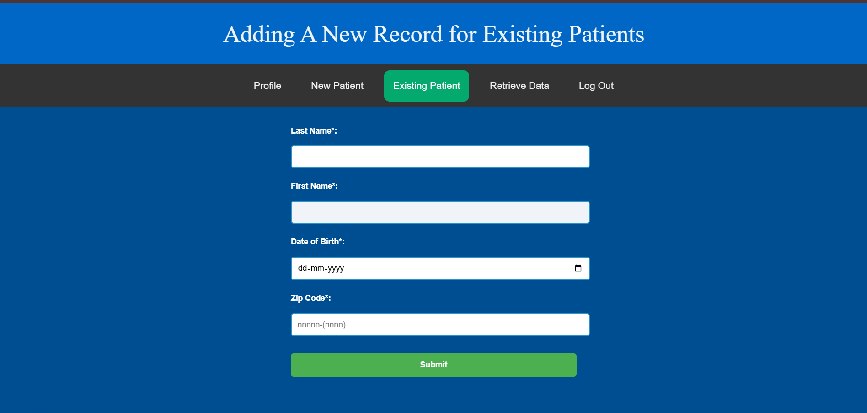
UI/UX Design and Implementation
Existing Patient
Segmented forms for:
Patient information.
Insurance details.
Vaccination records.
Real-time validation for accurate data entry.

Slide 8
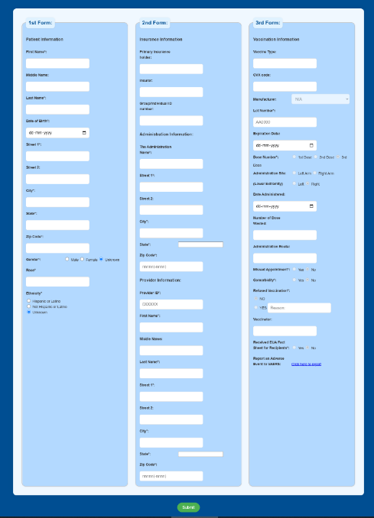
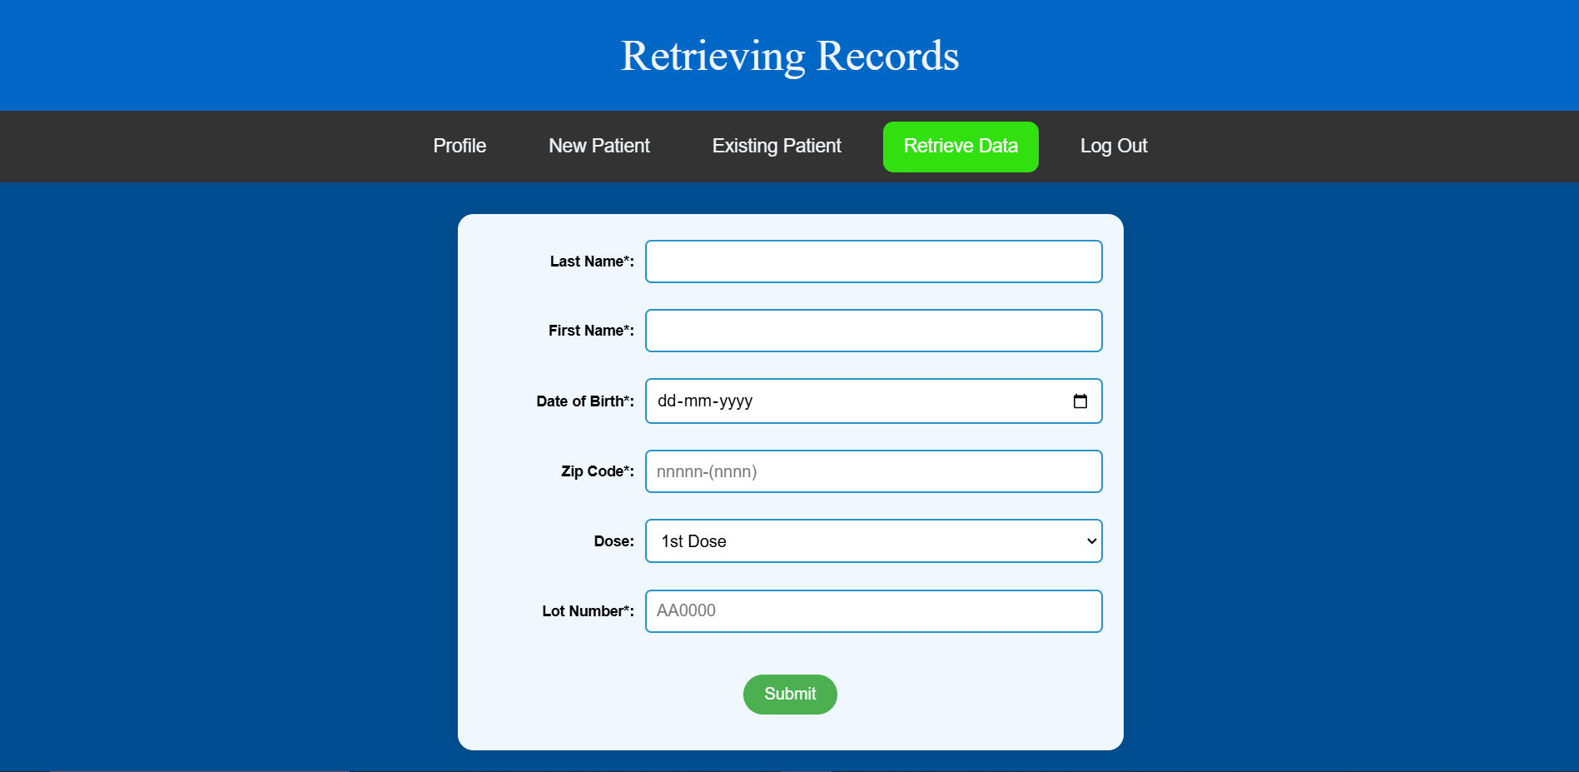
UI/UX Design and Implementation
Retrieve Data:
Simple interface for querying vaccination records based on patient and vaccine details

Slide 9
Innovation and Usability
Innovations
Usability
Real-time validation.
Modular design for scalability.
Logical form segmentation.
Dropdowns and radio buttons for easy interaction.

Slide 10
DEMO

Slide 11
THANKS
Does anyone have any questions?

